Slide 1
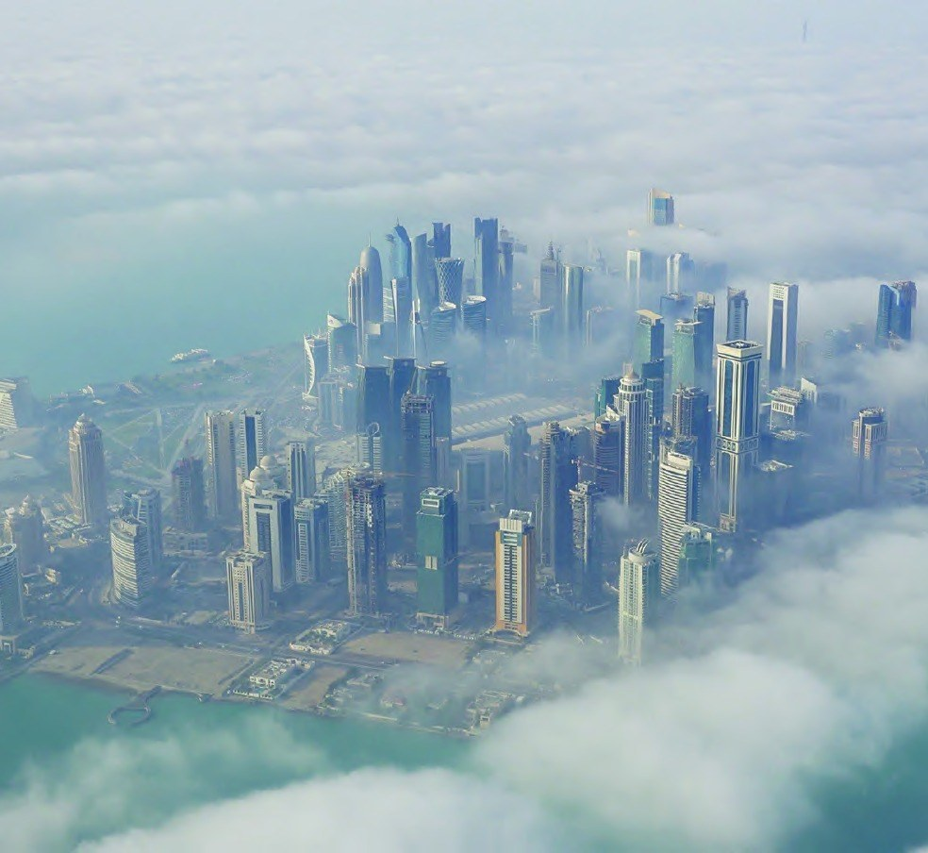
THIRTY FIVE
ثيـــــرتي فــــــاييف
BUSINESS COMPANY PROFILE 2026
Excellence. Sustainability. Legacy.
www.thirtyfiveholding.com

Slide 2
1.
Company Overview
03 - 05
4.
Mining
15 - 32
8.
Real Estate
44 - 54
1.1
AL ATTIYA GROUP
03
4.1
Thirty Five (SL) Limited
16
8.1
DIRO Real Estate Project
45
1.2
Thirty Five Investment Holding
04
4.2
Nmn gold rock africa
17
8.2
The Bentley Tower
46
1.3
Message from the Chairman
05
5.
Gold Refinery
33 - 36
9.
Healthcare
55 - 57
2.
Corporate Values & CSR
07 - 08
6.
Banking
37 - 38
10.
Trading & Global Resources
58 - 60
3.
Affiliations
10 - 12
7.
Agriculture & Food
39 - 43
11.
Logistics
61 - 62
Contents
Thirty Five | Contents
Company Profile 2026
2

Slide 3
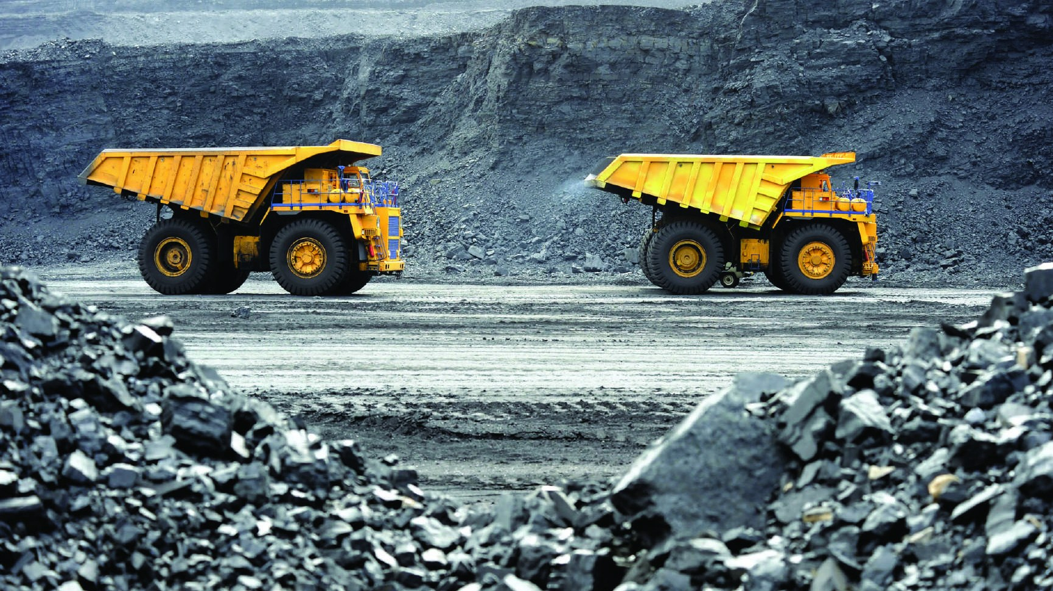
MINING

Slide 4
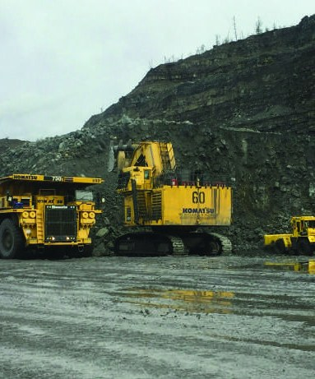
Nmn gold rock africa limited
Mining Project Uganda
Nmn Gold Rock Africa Limited is a company based in Uganda, primarily engaged in mining operations spanning transportation, exploration permits across a wide range of minerals, and the pursuit of exploration projects with the goal of exploitation.
A key investment in local economic development, contributing to the global supply chain of essential materials.
Thirty Five | Mining
Company Profile 2026
17

Slide 5
Nmn Gold Rock Africa Limited
Gold mining operations in Uganda spanning transportation, exploration permits and concession acquisition.
⌖ Uganda
OPERATIONAL
CORE
Key investment in local economic development that contributes to the global supply chain of essential materials.
Thirty Five | Mining
Company Profile 2026
17

Slide 6
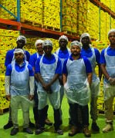
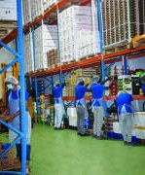
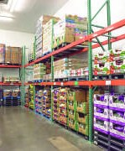
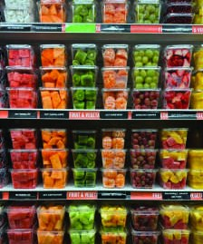
KBM Foodstuff
Food & Vegetables
• Aligned with Qatar National Vision 2030
• Fresh-cut vegetables, juices, ready-to-eat salads
• 70% of products acquired fresh by air via company farms
• Premium quality at a competitive price
KBM · Khalid Bin Mohd. F&V (W.L.L.)
Thirty Five | Agriculture, Food & Sweets Production
Company Profile 2026
41

Slide 7
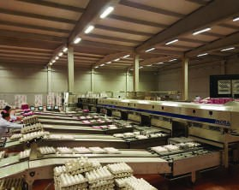

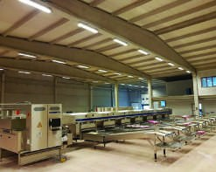
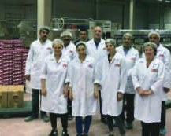
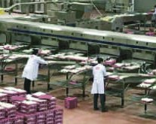
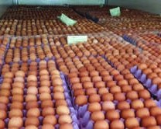
Anka Yumurta
Egg Production / Agriculture
Anka Yumurta is located in Ankara, Turkey. Primary production: eggs. Five years of serving customers across the region with the highest-quality, safest eggs in the most efficient way possible.
Thirty Five | Agriculture, Food & Sweets Production
Company Profile 2026
40

Slide 8
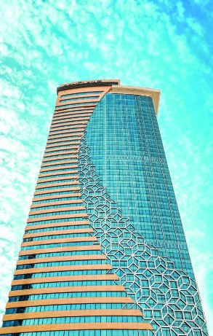
The Bentley Tower
Hotel, Resident & Retail / Qatar
Highest quality materials, attention to detail, elegant design with the spirit of luxury. The Bentley Tower introduces an innovative high-rise residential concept.
THE BENTLEY TOWER
• 432 Apartments
• 286 Junior Suites · 1-Bedroom
• 140 Executive Suites · 2-Bedroom
• 5 Royal Suites · 3-Bedroom
• Spa, Gym, Clubhouse
• Lower-roof outdoor 206 sqm pool
Thirty Five | Real Estate & Infrastructure
Company Profile 2026
46

Slide 9
UNITED KINGDOM
TURKEY
QATAR
SINGAPORE
Since 1985
Thirty Five — a second-generation business organization growing horizontally and vertically, expanding in diversified sectors and regions of the world.
Thirty Five | Company Overview
Company Profile 2026
6

Slide 10
“
“Today the Group covers a wide range of industries — including Automotive, Engineering, Manufacturing, Consultancy, Health, IT, and Training.”

Slide 11
THIRTY FIVE
ثيـــــرتي فــــــاييف
── THANK YOU ──
Excellence. Sustainability. Legacy.
www.thirtyfiveholding.com

